Slide 1
Controllers over Internet
Tomas Husak

Slide 2
Problem
Add your first bullet point here
Add your second bullet point here
Add your third bullet point here

Slide 3
Idea of solution

Slide 4
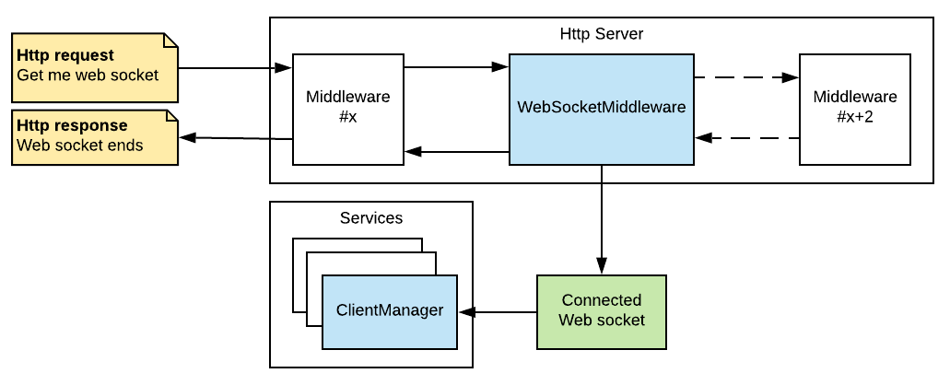
Pipeline

Slide 5
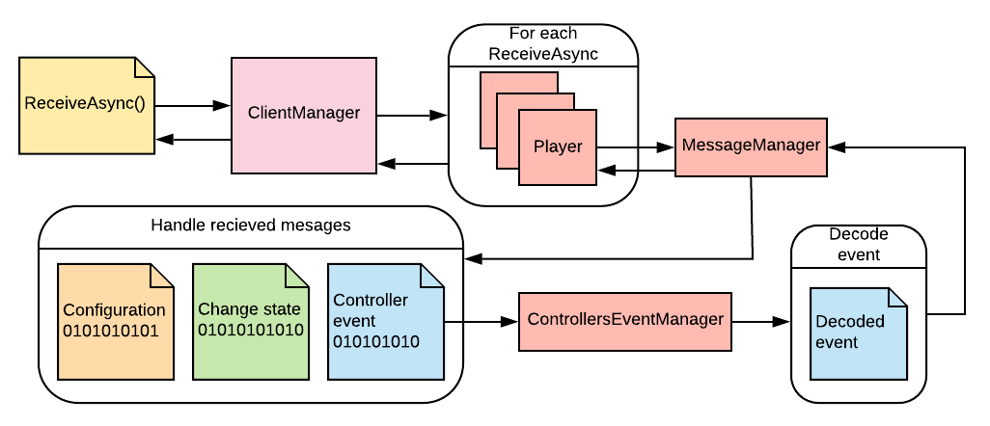
Client management

Slide 6
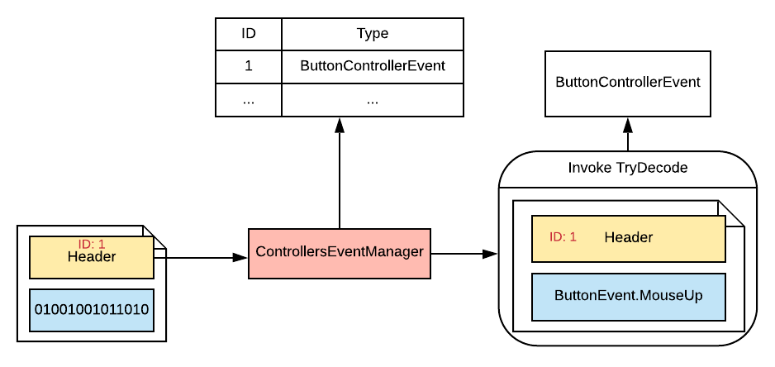
Event

Slide 7
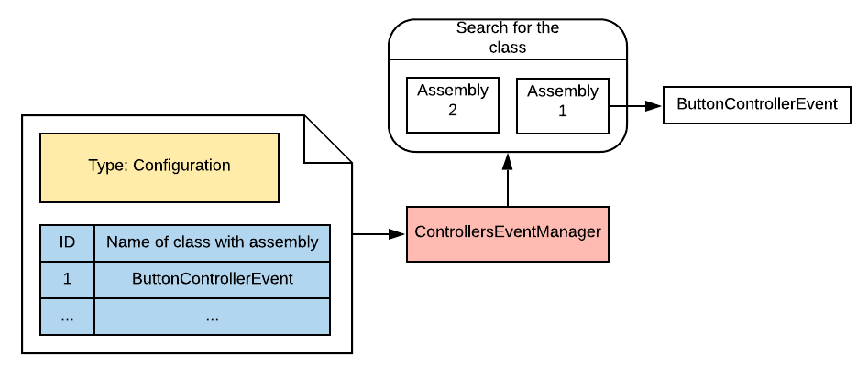
Finding .NET class

Slide 8
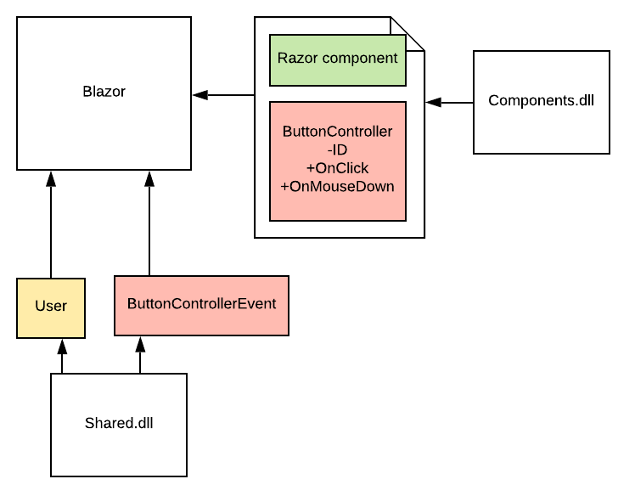
Blazor

Slide 9
Example

